Slide 1
Pacific Life Mortality Rate Project
Team Members:
Peter Gu
Wanyi Huang
Jianning Qiao
Wanruo Zhang
Company Supervisor: Tommy Steed, Cong Liu
Faculty Advisor: Tingting Nian

Slide 2
Agenda
Introduction
Model Improvement
Conclusion
Background & Objective
Data & Visualization
Feature Engineering

Slide 3

MSBA Program
The Master of Science in Business Analytics prepares future data scientists for a wide range of high-demand opportunities in big data and business analytics across a variety of industries throughout California and beyond.
Capstone Course:
Students practice academic knowledge
in the industry field.
Notes:
What do we learn in this program.
capstone, apply what we learned into real world industry

Slide 4




Who Are We?
Wanruo Zhang
MSBA Class of 2018
Background in Statistics
Skills: Data Analytics, Consumer Behavior
Interest: Culinery Arts, Music
Wanyi Huang
MSBA Class of 2018
Background in Accounting and Economics
Skills: Data Analytics, Problem Solving, Data Processing
Interest: Travel, Movies
Peter Gu
MSBA Class of 2018
Background in Finance and Economics
Skills: Project Coordination, Data Visualization
Interest: Comedy, Bartending
Jianning Qiao
MSBA Class of 2018
Background in Financial Services and Business Analytics
Skills: Advanced Data Management, Decision Making
Interest: Theater Art, Jazz

Slide 5
Background and Objective
Project Subject
PL’s deferred annuity policyholders
Project Objective
Review mortality research experience from PL’s deferred annuity block (both fixed and variable)
Investigate additional factors to that could be added to the current model used to predict mortality rate
Scope of the Project
PL policyholders nationwide over the time span from 2005 to 2014

Slide 6
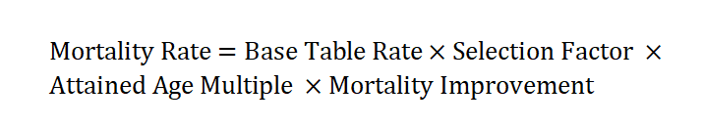
Background and Objective
PL Assumption:
Goals:
Identify and analyze the policy attributes that led to the disparity from the model, and improve the model according to the results of analysis
Provide business intelligence regarding mortality that can support marketing and operational strategies
Notes:
The selection factor is for the LGWB(Lifetime Guaranteed Withdraw Benefit).

Slide 7
Data
Main Datasets:
Dataset Name | Resource | Description
Output Exposure and Death | Pacific Life Insurance Company | Time series information for policyholders (death, gender, valuation_year, attained age, …)
Contract Information | Pacific Life Insurance Company | Static information on each unique contract (distribution channel, GIA, GPA, …)
Income Level | IRS website | Median income by state in 2014
Population Data | US Census Bureau | Estimate resident population by state in 2014

Slide 8
Introduction to Attributes
Attribute | Data type | Description
Death | Binary | 1 if the annuitant dies in the valuation year
Attained Age | Nominal | The age of policyholder in the valuation year
Gender | Category | 1 male, 2 female
Plus_Minus | Category | Minus: Policies with LGMWB riders; Plus: Policies without LGMWB riders.
Policy Year | Nominal | The number of years in force since the policy is issued
Income | Nominal | Median income by state in 2014
GIA | Category | A guaranteed minimum level of annuity payments regardless of the performance of your annuity
GPA | Category | Guaranteed Minimum Accumulation Benefit
Contract Qualified Indicator | Category | “N” = Not qualified = after-tax dollar; “Q” = qualified = pre-tax dollar
Distribution Channel | Category | B = IP (Independent Planners) F = FID [Financial Institutions (Banks, etc)] W = RW [Regional Wirehouses (e.g. Merrill Lynch, etc.)
Notes:
The process of the selection of the model

Slide 9
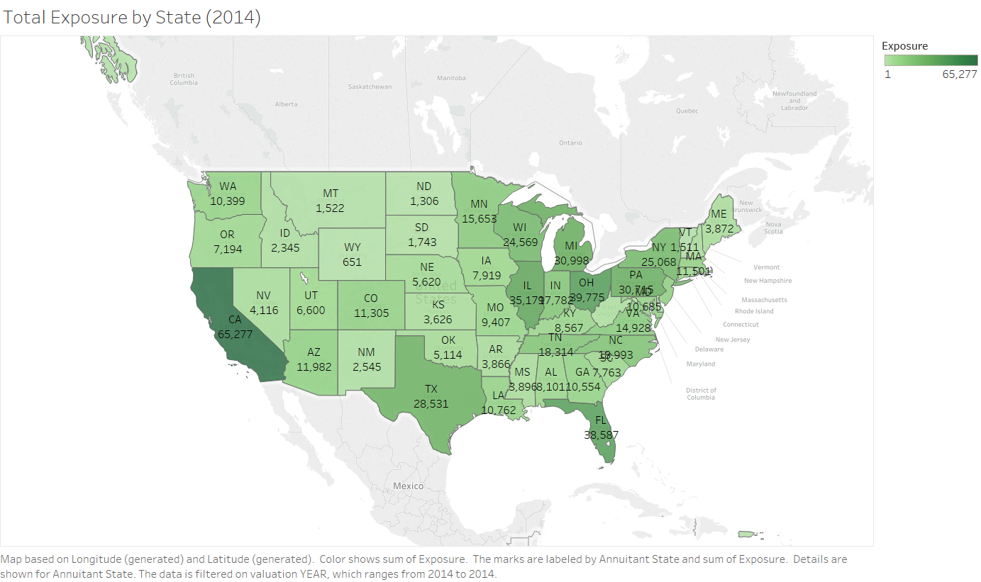
Policy Exposures (Year 2014)
States with the most exposures:
1st
California
2nd
Ohio
3rd
Florida
Notes:
market share

Slide 10
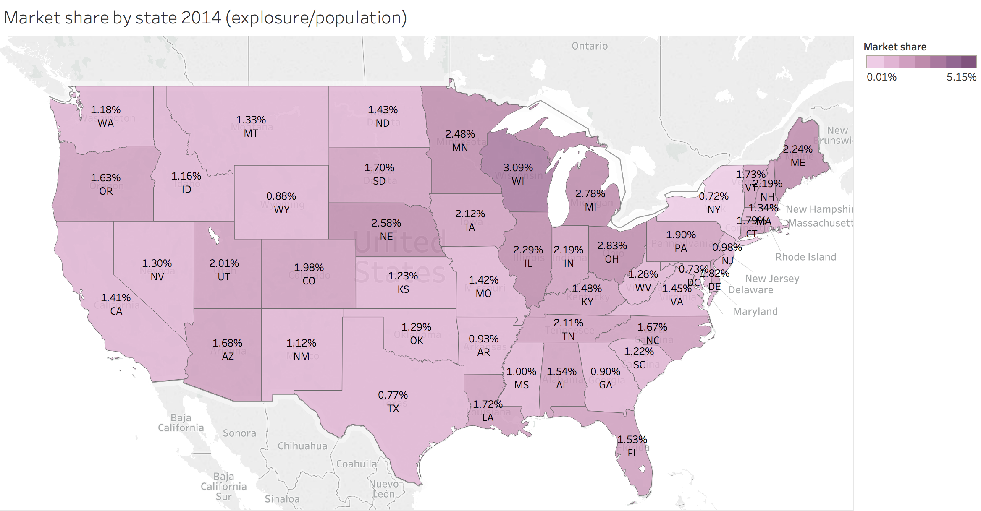
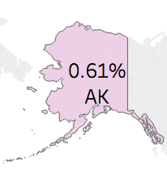
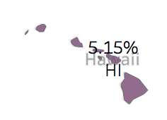
Market Share (2014)
Formula:
Market Share= Explosures/Population
Ranking:
1st
Hawaii – 5.15%
2nd
Wisconsin – 3.09%
3rd
Ohio – 2.83%
Notes:
policy numbers/total population

Slide 11
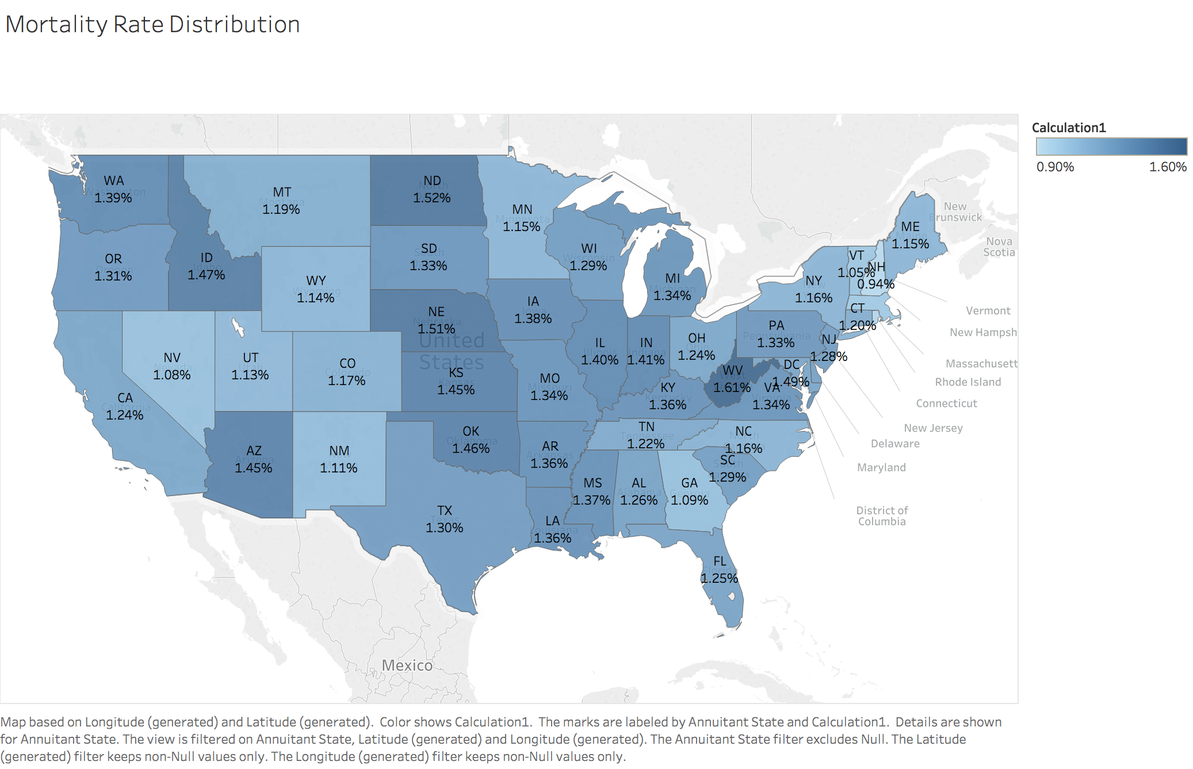
Mortality Rate by State (Not Age-adjusted)
Formula:
Mortality Rate=
Sum of Death / Sum of Exposures
Ranking:
1st
West Virginia
2nd
North Dakota
3rd
Nebraska
Notes:
death/exposure
influenced by the age of the people of the state
(not aged adjusted)
mention something that we worked on but not significant.

Slide 12
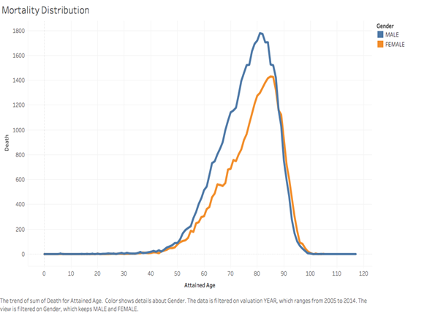
Age of Death
Mortality Distribution over 10 years (2005-2014) based on policyholders’ age and gender:
The peak mortality age for female annuitants is about 5 years older than male annuitants
Female: 86 years old
Male: 81 years old

Slide 13
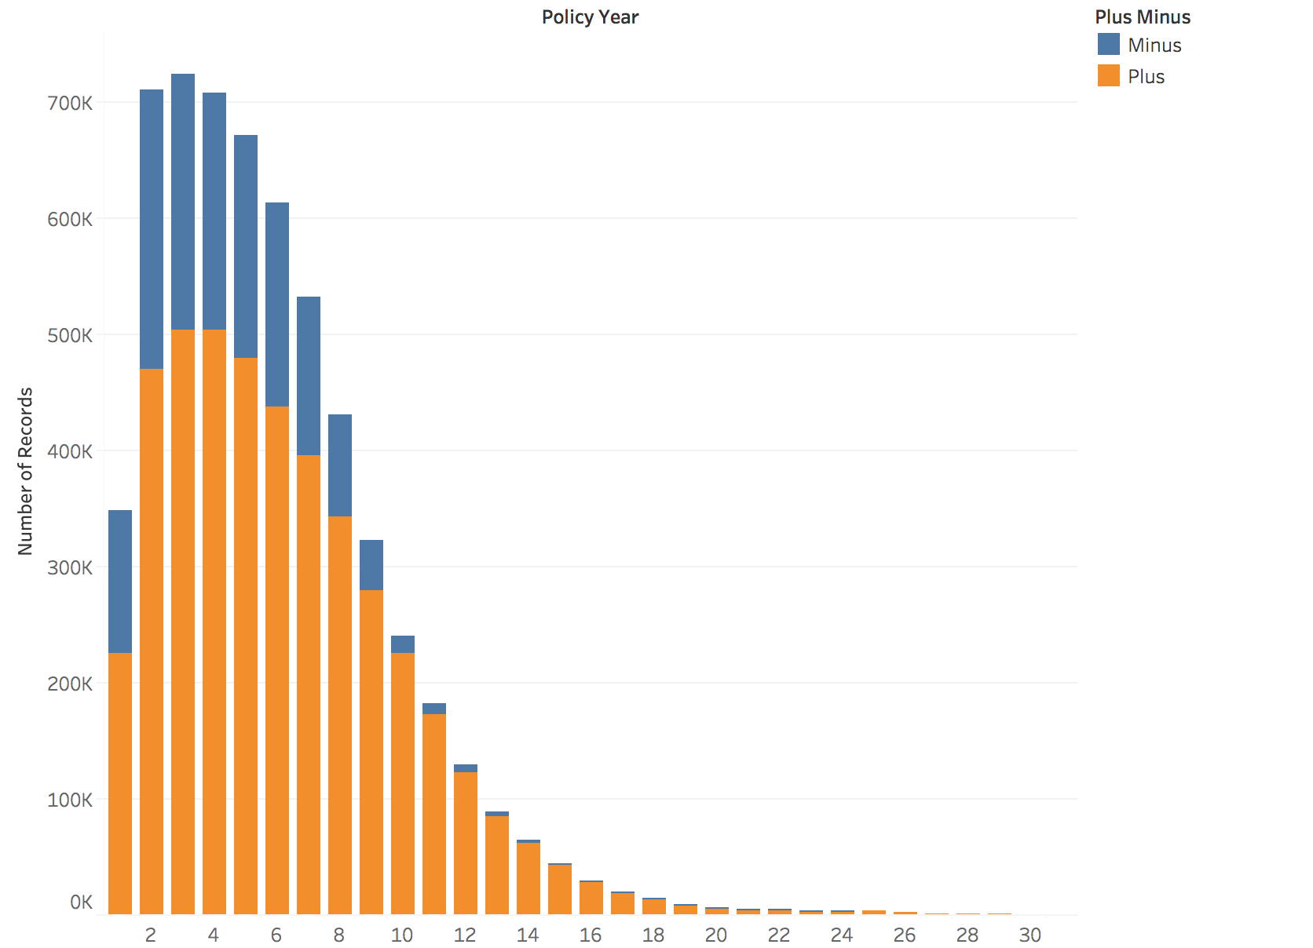
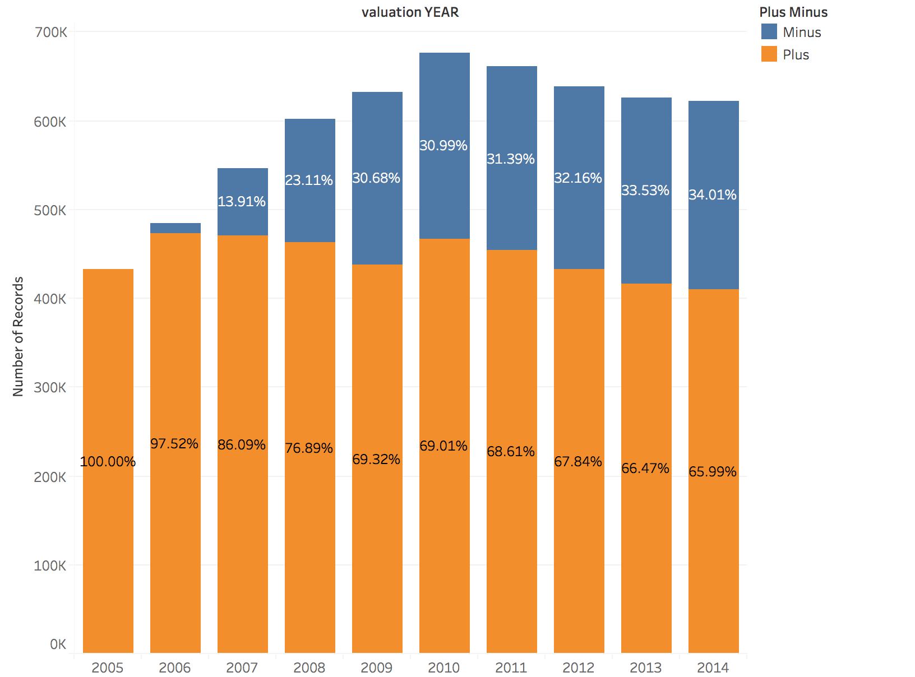
Plus vs Minus by Policy Year
Notes:
2005 was the first year we started selling Minus
valuation year minus appears in 2006
as poliy years increase, no longer minus

Slide 14
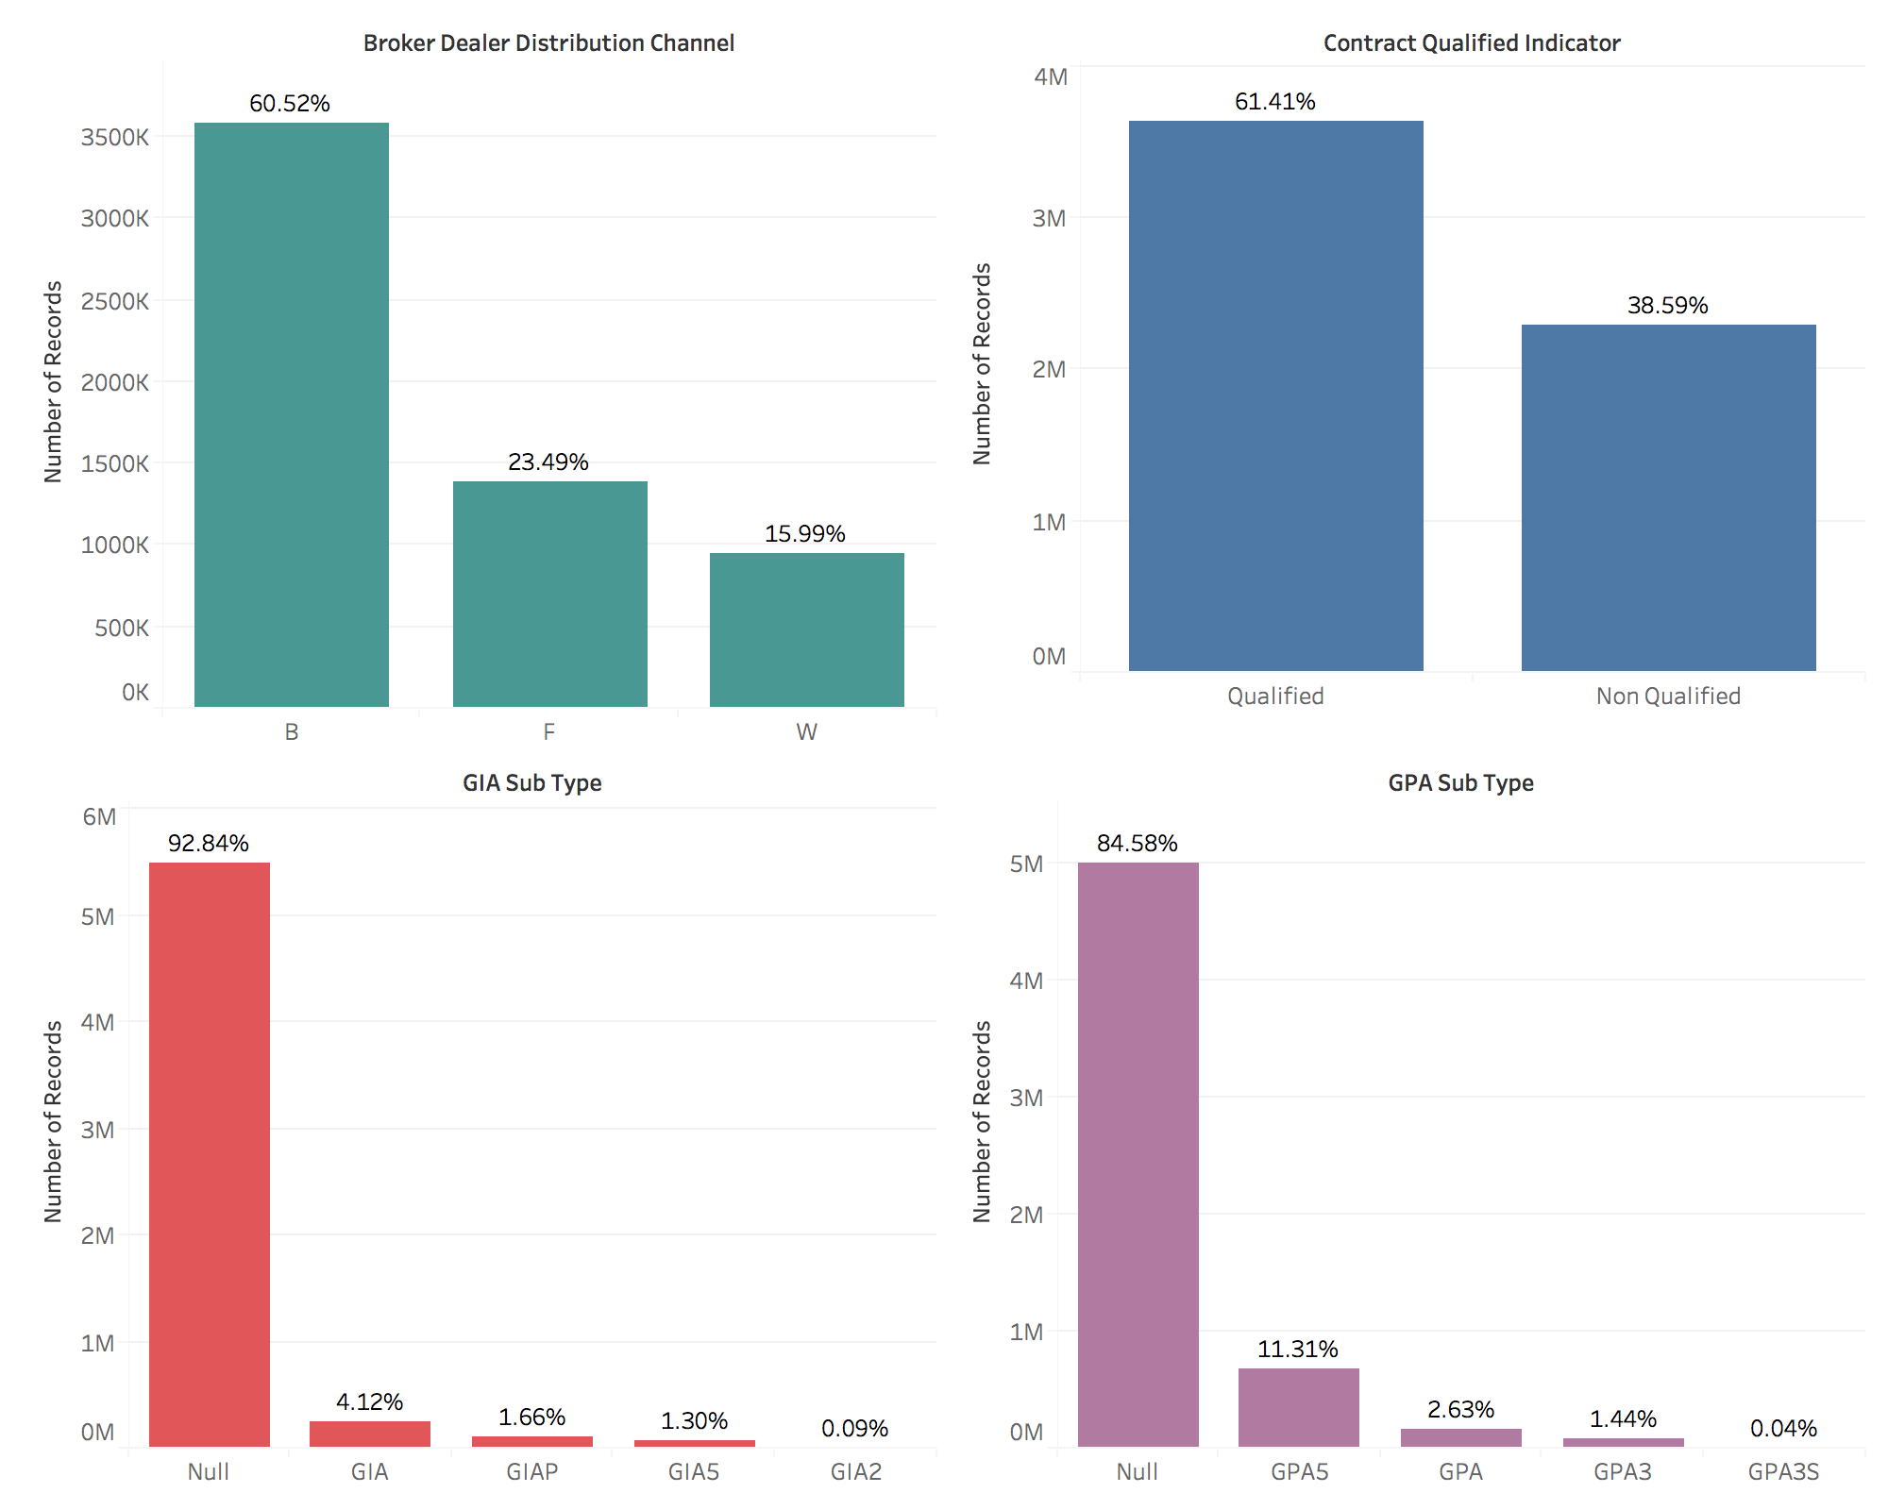
Notes:
B: Independent planner, F = FID [Financial Institutions (Banks, etc)], W = RW [Regional Wirehouses (e.g. Merrill Lynch, etc.)
o “Q” = qualified = pre-tax dollar
o “N” = Not qualified = after-tax dollar
guaranteed minimum income benefit,
Guaranteed Minimum Accumulation Benefit
if you purchase GIA, GPA, you need to wait about 10 years for the benefits. If you die, you just get your initial premium back. Use this as the explanation why the percentage is not too big. you both have to wait 10 years before it comes into effect.

Slide 15
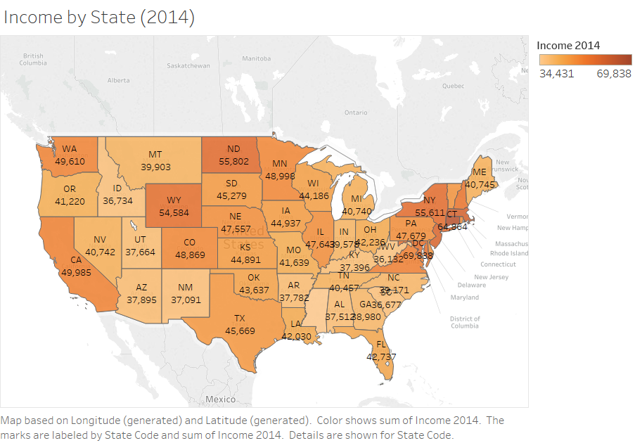
Income by State
States with the highest median income:
1st
District of Columbia
2nd
Connecticut
3rd
Massachusetts
4th
5th
New Jersey
North Dakota

Slide 16
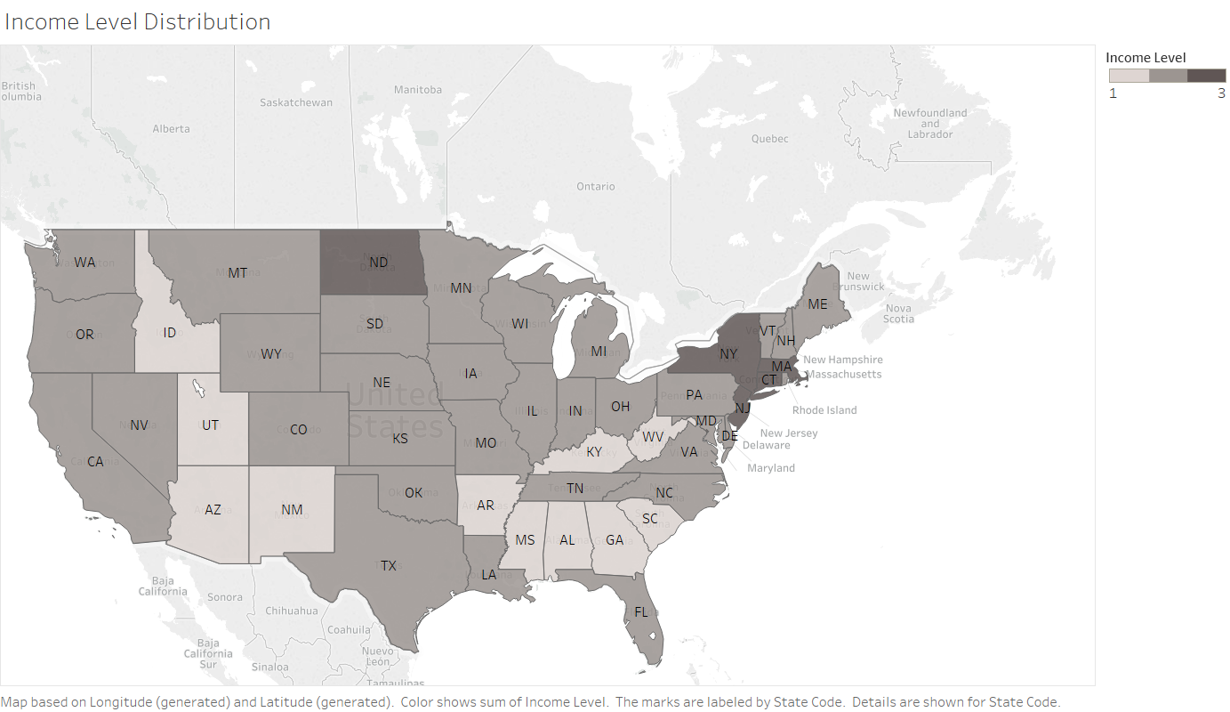
Income Level Distribution
States along the Missisippi River appear to have lower income in general
The North East region is wealthier compared to the rest of the states

Slide 17
Feature Engineering
Median Annual Income per Household by State
Income < $39,000
$39,000 <= Income < $55,000
Income >= $55,000
GIA
Null or Other
GPA
Null or Other

Slide 18
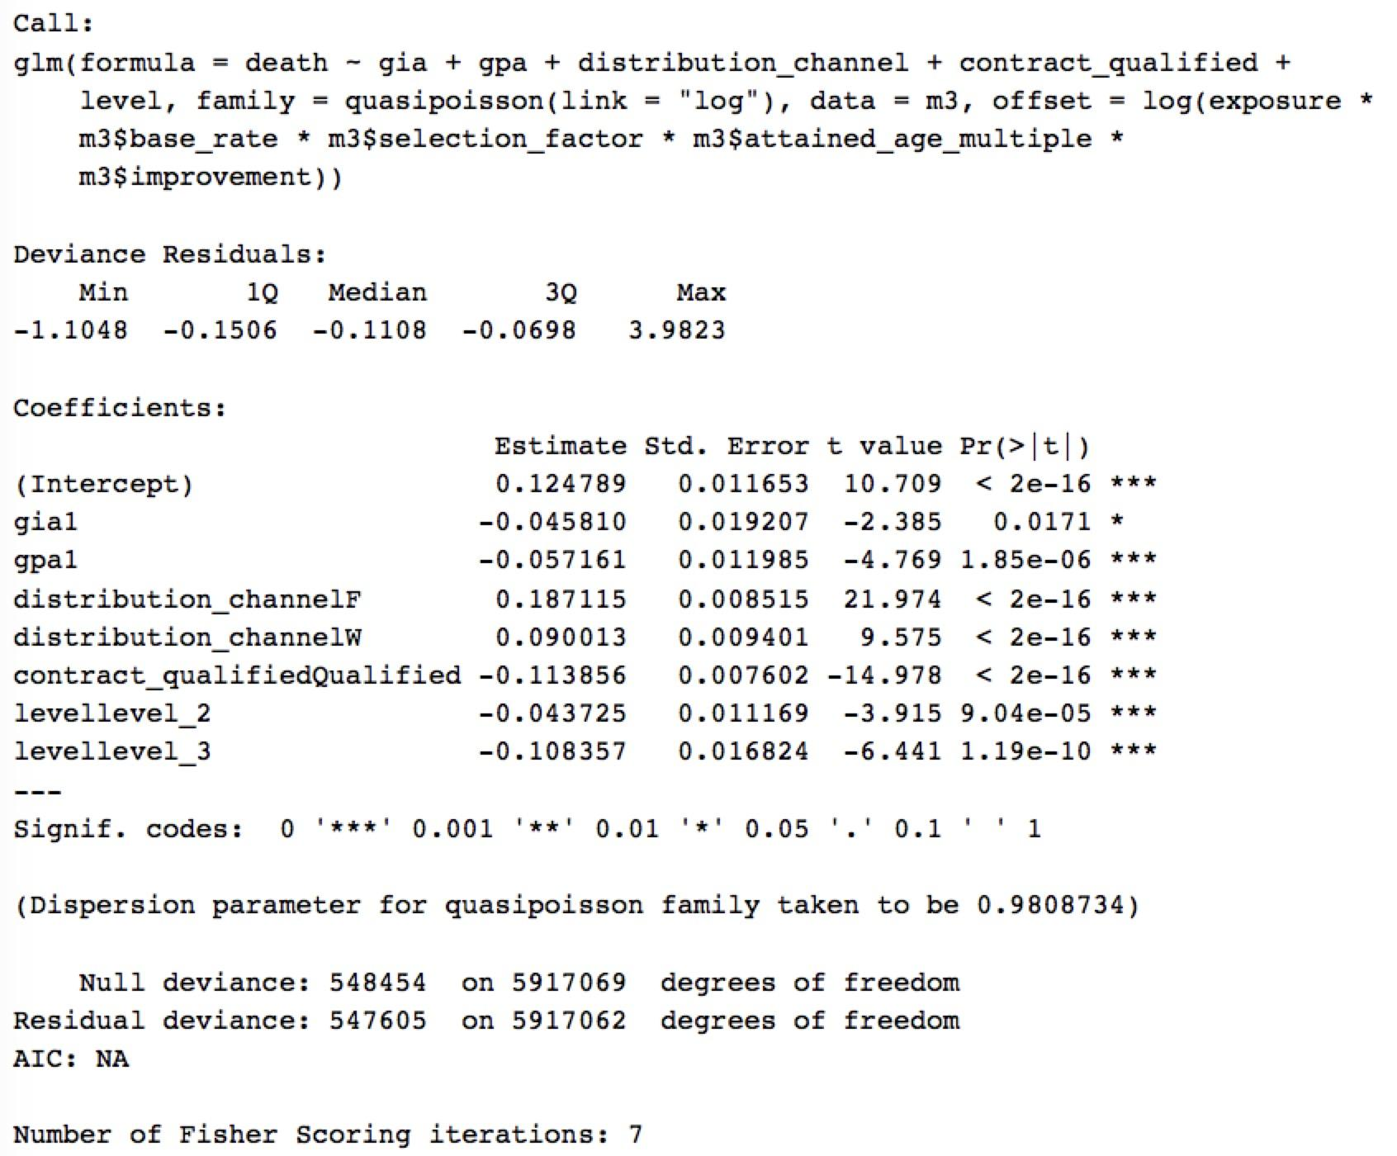
Model Formulation
DEATH = INTERCEPT + GIA + GPA + DISTRIBUTION_CHANNEL + CONTRACT_QUALIFIED + INCOME_LEVEL
Notes:
point out that they are all significant. Mention the offset values in the model.

Slide 19
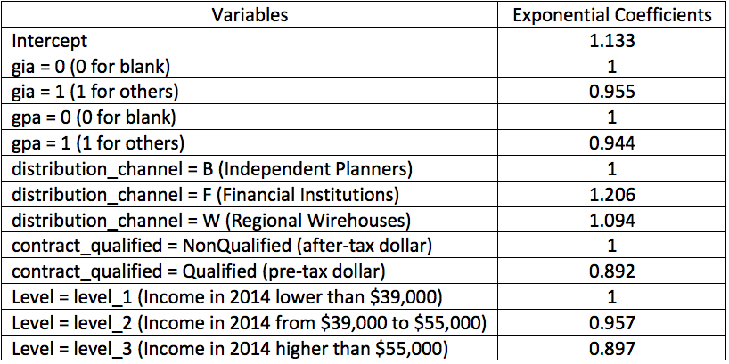
Transforming the Coefficients
Notes:
corr and mse: mean of squre errors.
mention what the intercept is. people with no gia, no gpa….
Just the base level.

Slide 20
Model Coefficients — Income Level
Coefficient
Income_level 1 = 1
Income_level 2 = 0.957
Income_level 3 = 0.897
Interpretation
Mortality rate decreased by 4.3% if in income_level 2 bracket
Mortality rate decreased by 10.3% if in income_level 3 bracket
Insight
Higher income -> better health
Notes:
which states are income level 1 and which states are income level2….show the heatmap.

Slide 21
Model Coefficients — GIA
Coefficient
GIA 0 = 1
GIA 1 = 0.955
Interpretation
Mortality rate decreased by 4.5% with GIA
Insight
People who purchase GIA are more confident about their health condition
More risk-aversed -> More health concern
Notes:
GIA(Guaranteed Income Advantage)
GIA = 1 : financially sophisticated people
self-selection
explain what the 4.5% is. Holding everything equal, just compare the GIA=0 and GIA=1

Slide 22
Model Coefficients — GPA
Coefficient
GPA 0 = 1
GPA 1 = 0.944
Interpretation
Mortality rate decreased by 5.6% with GPA
Insight
People who purchase GPA are more confident about their health condition
More risk-aversed -> More health concern
Notes:
GPA(Guaranteed Protection Advantage)
if you purchase the product, you need to wait about 10 years for the benefits. If you die, you just get your initial premium back. Use this as the explanation why the percentage is not too big. you both have to wait 10 years before it comes into effect.
GPA and GIA are actually similar.

Slide 23
Model Coefficients — Distribution Channel
Coefficient
distribution_channel B = 1
distribution_channel F = 1.206
distribution_channel W = 1.094
Interpretation
Mortality rate increased by 20.6% through distribution from financial institutions
Mortality rate increased by 9.4% through distribution from Regional Warehouses
Insight
Different products distributed through different channels
Different people distributed among different channels
Notes:
B = IP (Independent Planners)
F = FID [Financial Institutions (Banks, etc)]
W = RW [Regional Wirehouses (e.g. Merrill Lynch, etc.)
banks attract older people. many the higher mortality rate is age related.

Slide 24
Model Coefficients — Contract Qualified
Coefficient
non_qualified = 1
qualified = 0.892
Interpretation
Mortality rate decreased by 10.8% if qualified
Insight
People who are more knowledgeable on tax policies tend to be younger and be more aware of their health condition
Notes:
Qualified people mostly have 401k
Qualified population generally younger
older people have pensions
captured the components didn’t captured by attained age
Those results are based on this particular model with only 5 variables, when there are more variables the results might change.

Slide 25
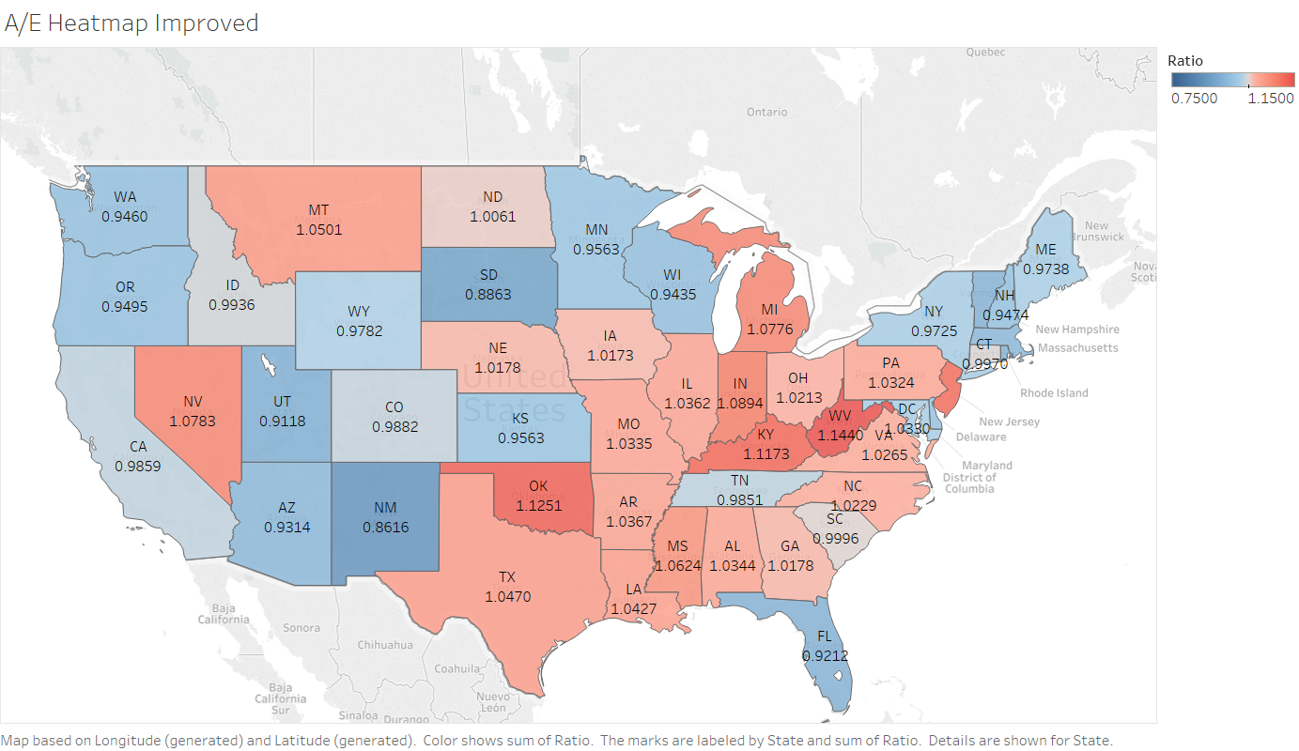
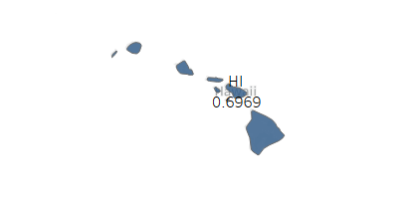
Model Improvement — A/E Distribution
Red: States where mortality is underpredicted
Blue: States where mortality is overpredicted
Best Fit: South Carolina, Connecticut, Idaho, North Dakota, California
Hawaii’s mortality is severely overpredicted
The mean squared error is reduced from 1.617 to 0.012.
Notes:
the mean squared error is reduced from 1.617 to 0.012 after adding policy variables compared to the original model
Reserve differently for different areas
Compare to simlar study
After four additional factors are accounted for
Mention Hawaii’s ratio
SD- Low data
Expand PL’s Pension Business based on this information

Slide 26
Challenges
Lack of domain knowledge
Little experience in processing large datasets
Not as experienced in poisson regression
Insufficient data source to apply more indepth analysis

Slide 27
Conclusion
GIA, GPA, Distributed Channel, Contract Qualified, Income Level can help predict Mortality Rate
PL’s primary market is in California, Ohio and Florida
A/E is closest to 1 in South Carolina, Connecticut, Idaho, and North Dakota using the enhanced model
A/E is furthest off 1 in Hawaii under the enhanced model

Slide 28



